Slide 1
Module 4 Attacks and Defenses
Section 4 – Credential Theft Attacks
June 2018

Slide 2
Agenda
Password Hashes
Pass The Hash (Pth)
Pass The Ticket (Pttc)
Countermeasures
Documentation
Quiz

Slide 3
.
Section 4 – Hardware attacks and mitigation
Learning Objectives
Explain attacks based on credentials theft
Password Hashes
Pass The Hash (Pth)
Pass The Ticket (Pttc)
Countermeasures

Slide 4
Password Hashes

Slide 5
What is a Windows Password hash?
Administrator:500:e52cac67419a9a22664345140a852f61:58a478135a93ac3bf058a5ea0e8fdb71
LMHash
NTHash
01
A password hash is a direct, one-way mathematical derivation of the password that changes only when the user’s password changes
02
You can authenticate to the server with the hash of the user’s password
You do not need to crack a password if you want to authenticate.
03
You use at least NTHash even when you use pure Kerberos

Slide 6
LM Password Hash
Password padded
with null to 14 characters
Converted to uppercase
Separated into two seven
character strings
Seattle1
=
SEATTLE
+
1******
Key
Key
Constant
DES
DES
Constant
KGS!@#$%
KGS!@#$%
Concatenate
LM Hash

Slide 7
NT Password Hash Generation
Hashes the password with MD4
Stores it in the SAM or in AD DS
Unicode password supported,
uppercase, limited
to 127 characters
Key
MD4
Key
Unicode
Password
Seattle1

Slide 8
Pass the Hash (PtH)

Slide 9
Pass The Hash (PtH)
1
The most popular credential theft and reuse attack Microsoft has seen to date. This type of attack is used in the majority of significant security breaches and enables the attacker to maximize the breach’s security compromise
2
First, an attacker obtains elevated read/write permission to privileged areas of volatile memory and file systems, which are typically accessible only to system-level processes on at least one computer
3
Second, the attacker attempts to increase access to other computers on the network by:
Stealing one or more authentication credentials from the compromised computer.
Reusing the stolen credentials to access other computer systems and services.
4
The intruder often repeats this sequence multiple times during the attack to increase the level of access he or she has to an environment.

Slide 10



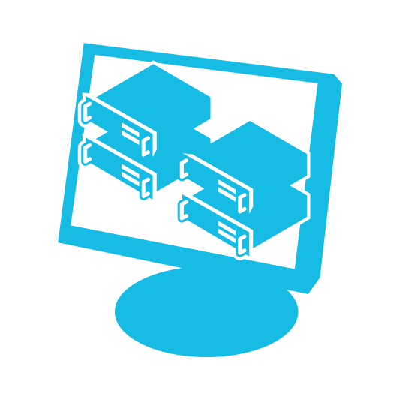

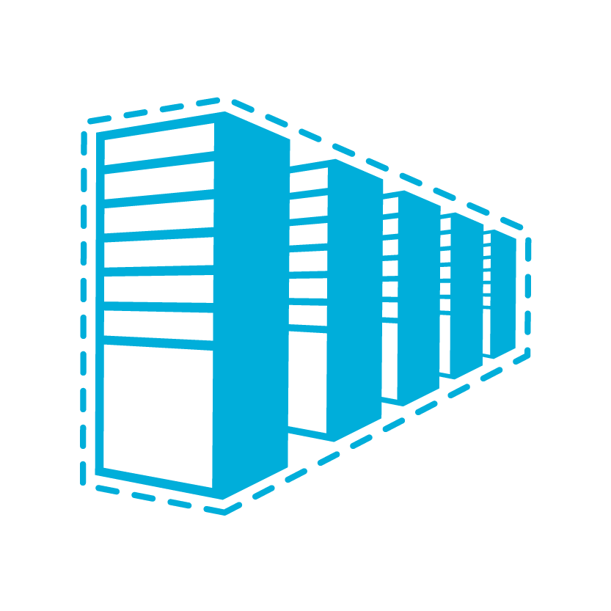


Typical Credential Theft Attack
Compromises administrative control
Tier 0
Domain &
Enterprise Admins
24-48 Hours
Directory Database(s)
Beachhead (Phishing Attack, etc.)
Lateral Movement
Steal Credentials
Domain Controllers
Compromise more hosts & credentials
Tier 1
Server Admins
Privilege Escalation
Compromise unpatched servers
Get Domain Admin credentials
Execute Attacker Mission
Steal data, destroy systems, etc.
Persist Presence
Tier 2
Workstation & Device Admins
Notes:
Key Message: Credential theft attacks can happen on just about conventionally secured environment and requires new types of defenses
This is a view of a typical attack on a typical environment.
The resources are broken out by the Microsoft Tiered administration model
Tier 0 – Full control of identities and all assets
Tier 1 – Full control of Enterprise Servers, Applications, and Cloud Services
Tier 2 – Full control of Enterprise Devices typically used by individual
*CLICK 1*
Attacks start by gaining control of a beachhead in your network, sometimes called “Patient Zero”.
[Attacker] This is usually a phishing attack, but can also be done by compromising a website frequently visited by your users, by delivering malware through advertising, or other techniques.
[Green Circle] Most attackers target domain controllers to gain access to all identities
*CLICK 2*
The next step for attackers is typically to gather credentials available on the compromised machines (including local administrator password hashes)
They then move laterally within that Tier to compromise other computers and harvest more credentials
This requires the attack to be an administrator on the local machine. This can happen when
A user running as a local admin clicks “allow” on a security warning dialog in a browser or other application
Attacker exploits an unpatched vulnerability on a computer (whether the user is running locally as local admin or only with standard user privileges)
*CLICK 3*
The attackers can directly attempt to escalate their access to the environment by directly attacking servers
*CLICK 4*
More commonly, we see privilege escalation by stealing higher tier credentials (e.g. domain admins) where they are exposed on lower tier devices (e.g. standard workstations)
This leads to an attacker gaining full control of the environment
This is a shared state of control, so it doesn’t “kick out” the real admins
This attack is very difficult to detect with conventional means because attackers are using real legitimate credentials (and can then move to creating fake accounts, install malware on any computer, etc.)

Slide 11
Pass The Hash (PtH)
An attacker who has stolen a user account’s credentials has access to all the resources, rights, and privileges of that account
If the compromised account is a privileged account, such as a domain administrator account, the attacker gains domain administrative rights
For an attacker to reuse a stolen password hash on another host, he or she must meet the following requirements:
The attacker must be able to contact the remote computer over the network, and the computer must have listening services that accept network connections.
The account and corresponding password hash value the attacker obtained from the compromised computer must be valid on the computer to which the attacker is authenticating (for example, if both computers are in the same domain or local accounts with the same user name and password exist on both computers).
The compromised account must have the Network logon user right on the remote computer.

Slide 12
Pass The Hash (PtH)
lists the types of PtH attack activities an attacker can perform after the initial compromise
Attack activities | Description
Lateral movement | The attacker uses the credentials he or she obtained from a compromised computer to gain access to another computer of the same value to the organization. For example, the attacker could use stolen credentials for the built-in local Administrator account from the compromised computer to gain access to another computer that has the same user name and password.
Privilege escalation | The attacker uses the credentials he or she obtained from a compromised computer to gain access to another computer of greater value to the organization. For example, an attacker who has compromised a workstation computer could gain administrative access to a server computer by stealing the credentials of server administrators who log on to the compromised workstation.

Slide 13
Need of administrative Access
1
2
3
The attacker must have administrative access on the initial compromised computer to steal these credentials
Administrative access to a computer can include the ability to run a program or script with an account in the local Administrators group
Attackers can also achieve this type of access through administrator-equivalent privileges, such as those used to debug programs, loading and unloading device drivers, and take ownership privileges

Slide 14
Pass The Hash (PtH)
With administrative access, an attacker might be able to steal credentials from several locations on the computer, including:
The Security Accounts Manager (SAM) database.
Local Security Authority Subsystem (LSASS) process memory.
Active Directory database (domain controllers only).
The Credential Manager store.
LSA Secrets in the registry.

Slide 15
Demonstration

Slide 16
Situation
We will see how an attacker who has successfully compromised a server can retrieve the password hashes of the users who will connect

Slide 17
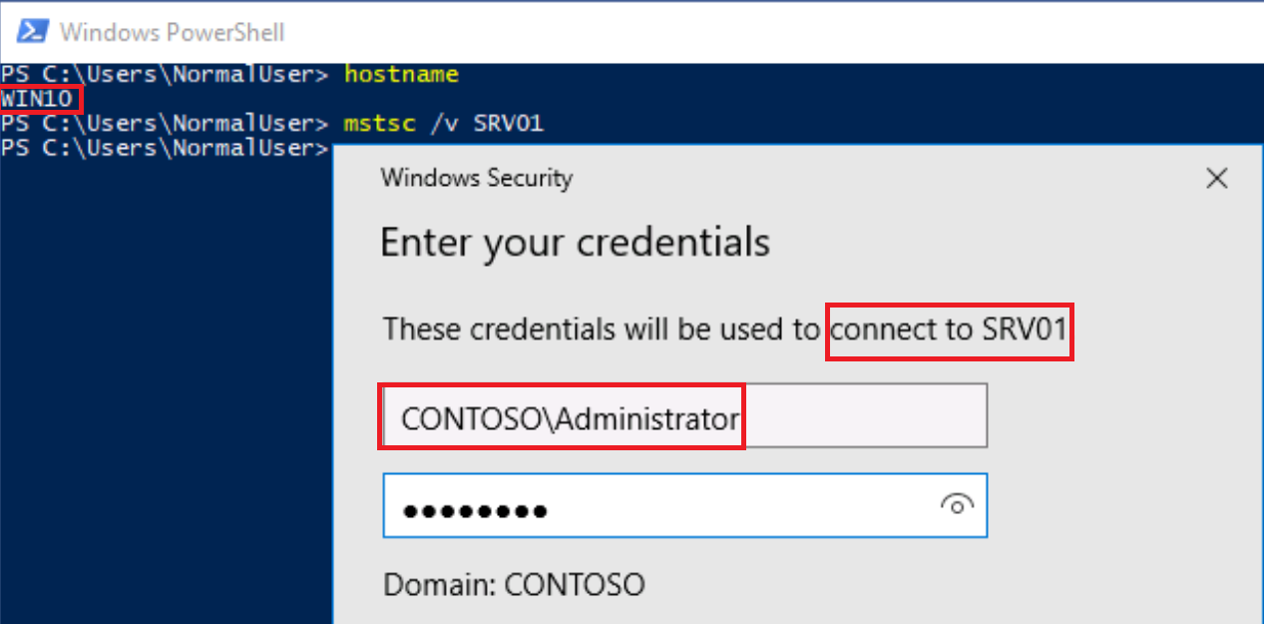
RDP connection to SRV01
From WIN10 workstation,
an administrator initiate RDP
connection to SRV01 with
an account with domain
admins privileges.
Key
Key

Slide 18
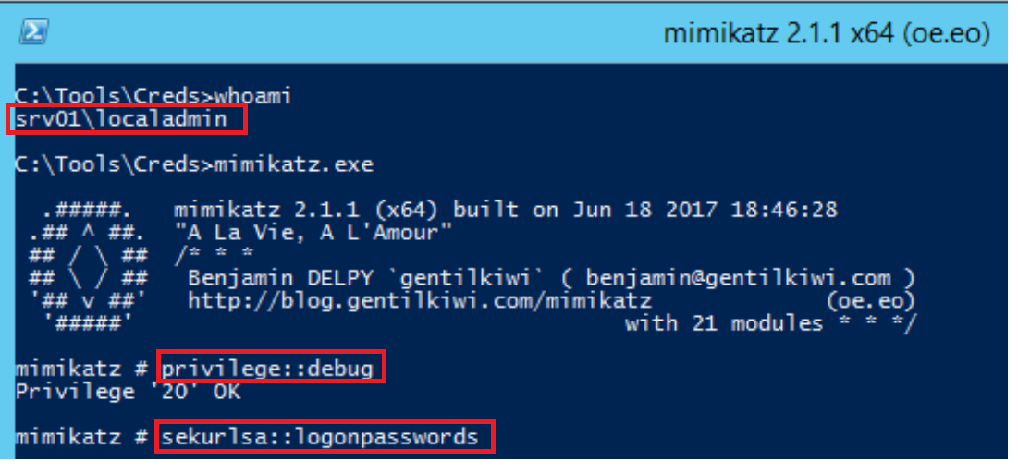
Successfully start of Mimikatz.exe
Connected on SRV01 with local
admin privilege, the attacker started
Mimikatz.exe, got the “SeDebugPrivilege”
and launch the command
“sekurlsa::logonpasswords” to dump
credentials from lsass
Key

Slide 19
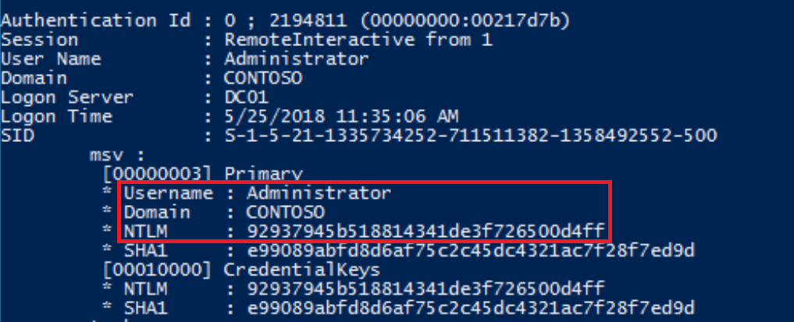
Credentials dump
The attacker can get the credentials of Remotely connected administrator.
As a reminder, You can authenticate with the hash of the user’s password. You don’t need to crack password if you want to authenticate.
Key

Slide 20
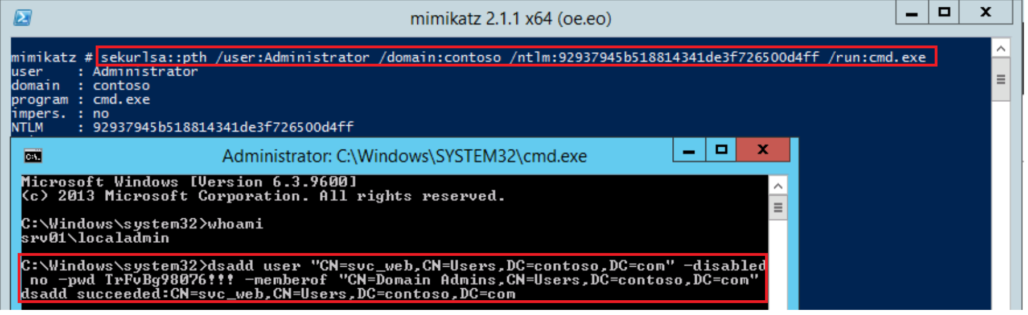
Impersonation
The attacker stay connected with local administrator privileges. He impersonates domain administrator account with credentials previously retrieved and ran cmd.exe as administrator
He created an account “svc_web” and
added him to the Domain Admins group.
Key

Slide 21
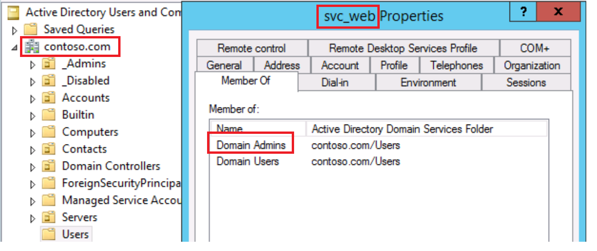
End of the attack
The account created by the pirate is now
Member of Domain Admins group.
Attacker has now the total control of the
environment
It only needed one local administrator
account to become Domain administrator
Key

Slide 22
Invoke mimikatz from internet
It is also possible to invoke Mimikatz.exe directly from Windows PowerShell if you have an internet connection.
Key

Slide 23
Pass the Ticket (Pttc)

Slide 24
Pass the Ticket (Pttc)
1
Occur less frequently than PtH attacks.
2
Resembles a PtH attack in its execution.
3
Requires that the attacker obtain local administrative access to capture the stored ticket-granting tickets (TGTs) before reusing them with the Kerberos protocol.
TGTs have a default lifespan of about 10 hours and a default total lifetime of 7 days if that TGT is always renewed before it expires.
4

Slide 25
Pass the Ticket (Pttc)
A
B
C
Attackers can steal TGTs and associated session keys and request new Service tickets, which are the credentials used to connect to a specific resource. He can continue this cycle until the TGTs have reached the renewal lifetime, which means that a compromised TGT may allow an attacker to use stolen credentials for up to 7 days, assuming that you have configured the default Kerberos TGT lifetime.
Because of the limited lifetime, attackers often collect many TGTs so that as one expires they can use another and continue the attack.
A significant difference in the attack value between the NT hashes that NT LAN Manager (NTLM) authentication uses and TGTs is the useful lifetime of the compromise. Password hashes are reusable until the user’s password changes, while TGTs expire in a matter of hours according to their configurable lifetime.

Slide 26
Demonstration

Slide 27
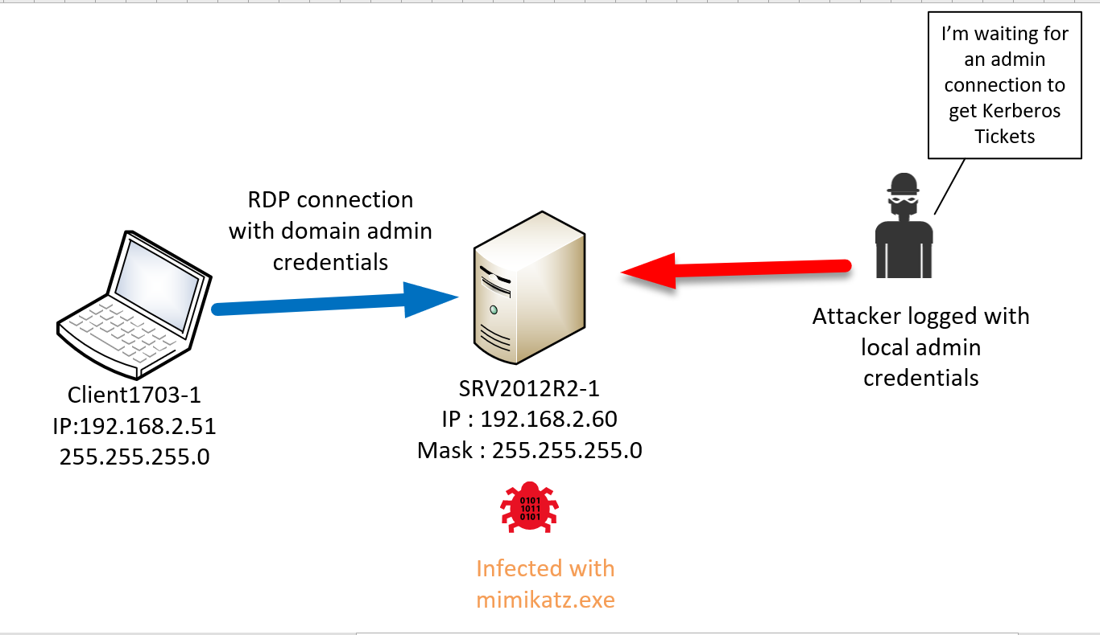
Situation
We will see how an attacker who has successfully compromised a server can reuse the TGT of a legitimate
administrator

Slide 28
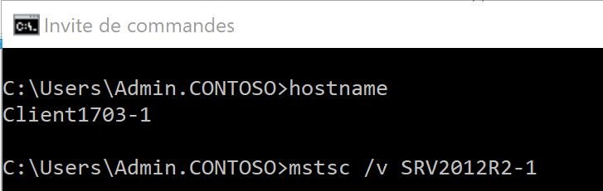
RDP connection to SRV2012R2-1
From Client1703-1 workstation,
an administrator initiate RDP
connection to SRV2012R2-1 with
an account with domain
admins privileges.
Key
Key

Slide 29
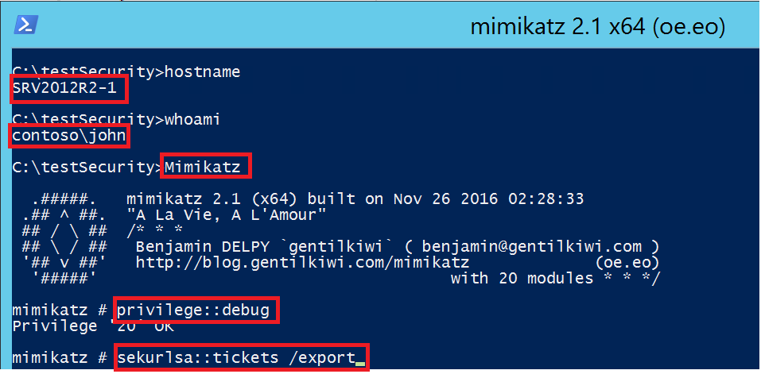
Export Kerberos tickets
Connected on SRV2012R2-1
with a domain account “john” with
local admin privilege,
the attacker started Mimikatz.exe,
got the “SeDebugPrivilege”
and launch the command
“sekurlsa::tickets /export” to export
all Kerberos tickets present in
lsass process.
Key
Key

Slide 30
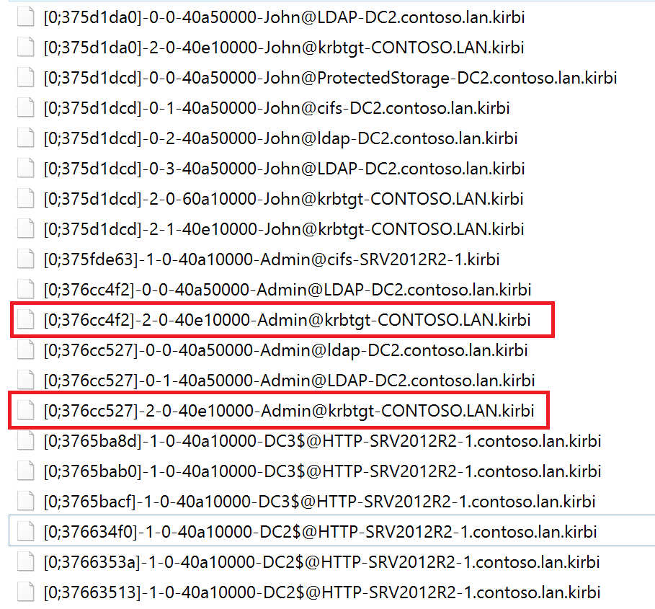
Exported Kerberos tickets
Now, the attacker has all the tickets
that were present on the server. So,
he can extract only TGT of remotely
connected administrator
The pirate’s goal is to reuse the
exported TGT.
Key
Key

Slide 31
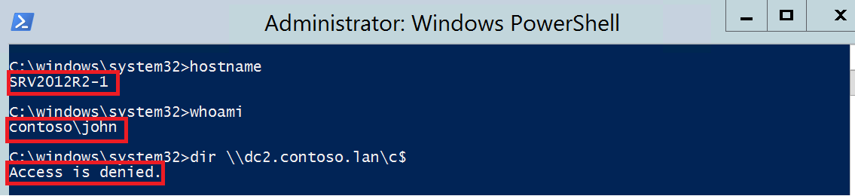
Browse admin share
The pirate try to browse an admin
share on domain controller
from SRV2012R2-1 with a domain
account that has only local
administrator privileges.
Access is logically denied
Key
Key

Slide 32
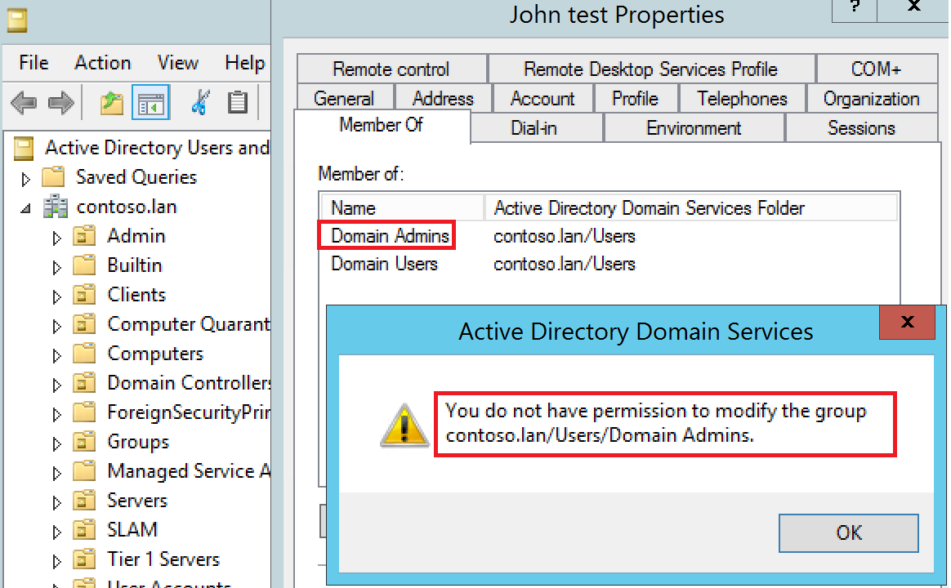
Add John to Domain Admins group
The pirate try to add himself to
Domain Admins group from
SRV2012R2-1 with a domain
account that has only local
administrator privileges.
The attacker don’t have the
Permission to modify this group.
Key
Key

Slide 33
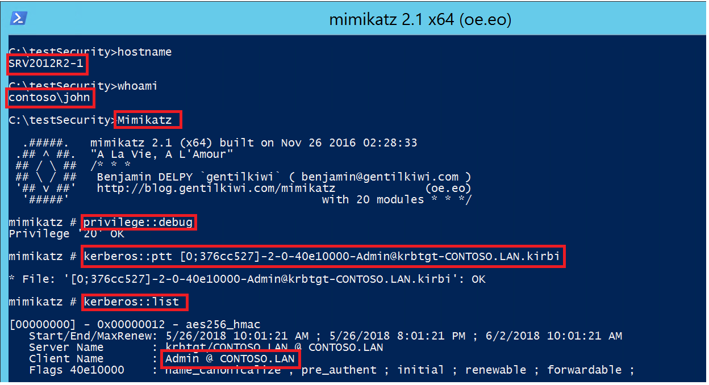
Reuse TGT
Connected on SRV2012R2-1
with local admin privilege, the attacker
started Mimikatz.exe, got the
“SeDebugPrivilege” and launch the
command “Kerberos::ptt” with the
previously exported TGT.
The pirate can now impersonate the
remotely connected administrator
Key
Key

Slide 34
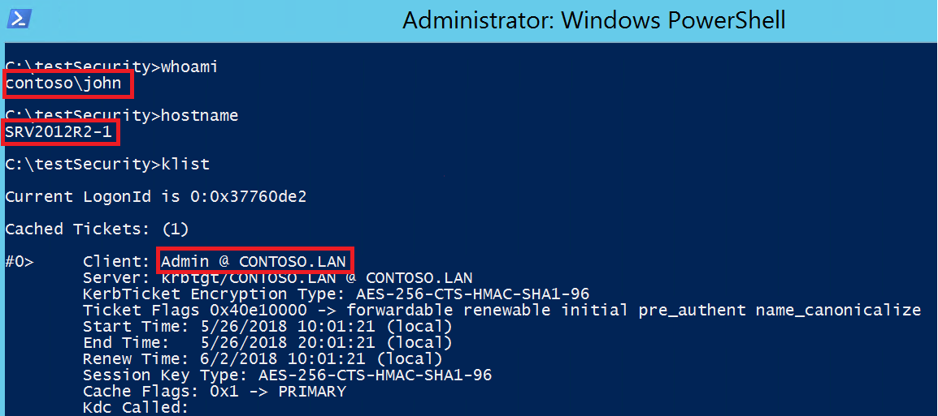
Reuse TGT
The attacker stay connected with local administrator privileges on SRV2012R2-1.
The pirate use “klist” command to list all the tickets for the currently logged on user.
Now, he has the TGT of admin.
Key

Slide 35
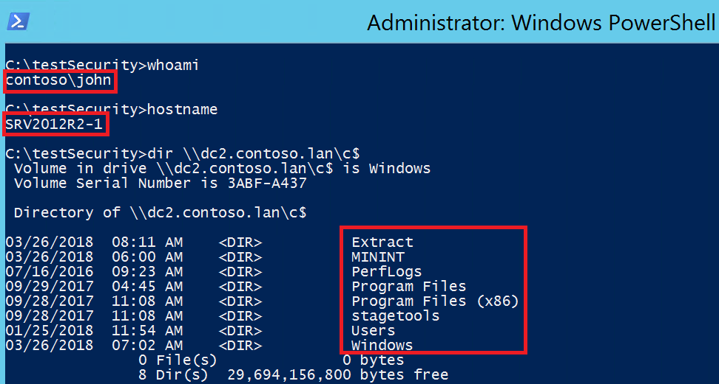
Browse admin shares
The attacker stay connected with
local administrator privileges on
SRV2012R2-1.
Now, he can impersonate administrator
and browse admin shares on domain
controller.
Key

Slide 36
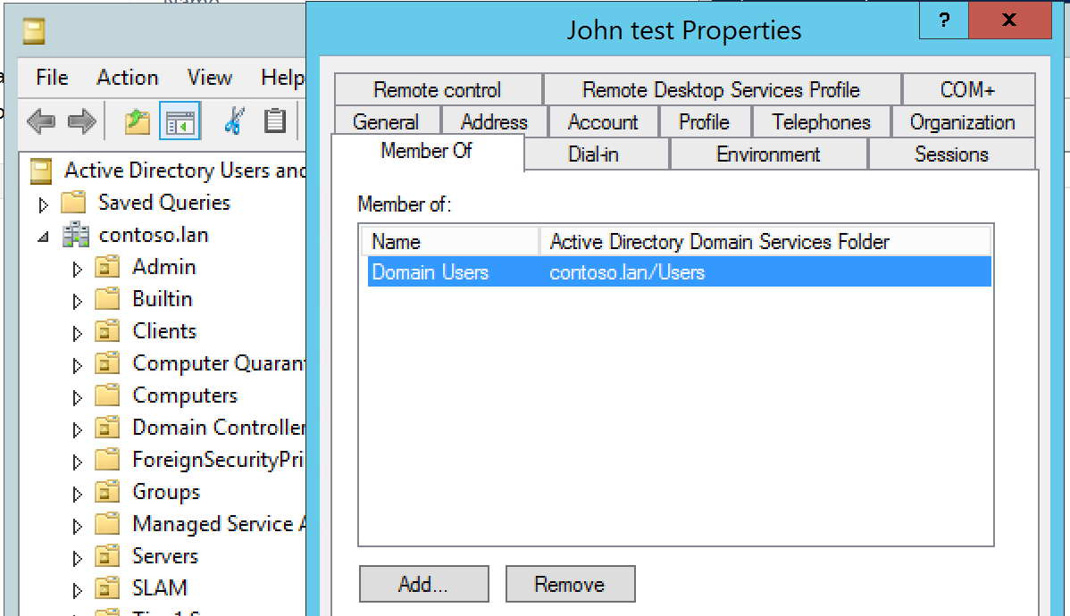
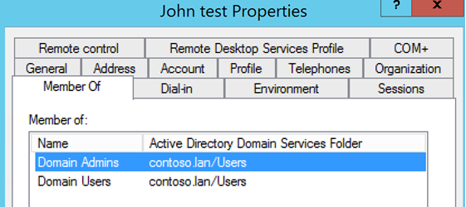
Add John to Domain Admins group
The attacker can now add John to the
domain admins group.
Key

Slide 37
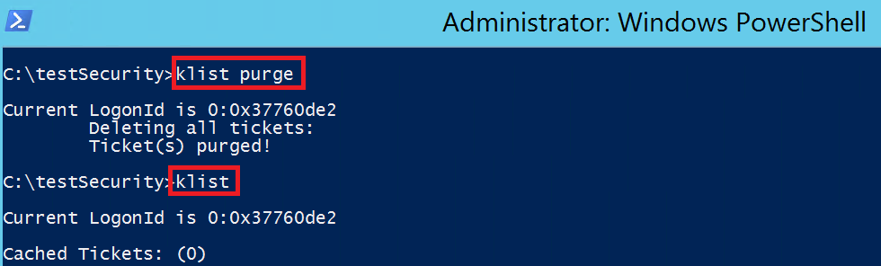
Klist purge
The pirate can impersonate
administrator during lifetime of TGT.
If TGT expired or ticket(s) are purged,
attacker will not be able to impersonate
anyone.
the pirate will have to import again valid
ticket(s).
Key

Slide 38
Countermeasures

Slide 39
Prioritize high-value accounts and computers
You have to understand your network from the attacker’s perspective, especially during identification and planning. When attackers gain a foothold on a new network, they typically ask:
What are the assets we want access to (for example., domain controller, certification authority [CA], email server, jump server, Remote Desktop server, file server)?
Who has access to those assets (who are the administrators on these servers)?
Where can we get access to those credentials (what servers can we compromise to capture the credentials of a target user or administrator)?
What do I need to compromise first?
An attacker’s first step is to understand his or her target, so you must take a similar approach. By identifying both legitimate and possible unauthorized access patterns, you can more effectively tailor the strategies this paper describes to your organization.

Slide 40
Prioritize high-value accounts and computers
Eventually, you need to protect all assets in your organization. Realistically, though, you can’t implement strong security simultaneously across the board. You need to know which assets should come first to help you build an implementation plan
A good place to start when identifying high-value assets is with the accounts and hosts you use to manage IT assets: these elements are the assets attackers target to escalate privileges
Hosts that are expected to use high-value accounts:
Computers used for administration
Computers used for support, such as help desk
Patch management servers
Security scanners

Slide 41
Prioritize high-value accounts and computers
Accounts that administrators use to manage domain controllers. For example, if Microsoft System Center Operations Manager or System Center Configuration Manager runs on domain controllers or any server that a domain administrator–equivalent account logs on to, then System Center Operations Manager and System Center Configuration Manager administrators are effectively domain administrators.
Domain administrator and domain administrator–equivalent account members of the following Active Directory security groups:
Domain Administrators
Enterprise Administrators
Schema Administrators
Account Operators
Backup Operators
BUILTIN\Administrators
This list is just a sample of the more common high-value accounts. The specific list of high-value accounts and criteria are different in each organization. You need to consider which apply to your organization. For additional guidance on identifying and prioritizing assets, see the the Privileged Access Workstations page

Slide 42
Identify normal behaviour
To properly implement mitigations and enable detective controls later, you must identify the current state of existing administrative practices and how you use other high-value accounts. This process may include identifying:
Who has access to what resource.
How resources are being accessed.
Which applications should be run on high-value hosts.
Understanding how these high-value accounts and computers should behave helps you define cases of unauthorized use. You can monitor normal behavior for deviation and protect your systems through mitigations.

Slide 43
Establish a containment model for account privileges
1
2
3
Tier 0: Forest admins. Direct or indirect administrative control of the Active Directory forest, domains, or domain controllers
Tier 1: Server admins. Direct or indirect administrative control over a single or multiple servers
Tier 2: Workstation admins. Direct or indirect administrative control over a single or multiple devices
the attacker cannot steal domain accounts that have never been used to sign on to the compromised computer

Slide 45
Implement administrative practices
1
2
3
Limit the number of hosts on which administrative credentials are exposed.
Limit role privileges to the minimum required.
Ensure that IT pros don’t perform administrative tasks on hosts used for standard user activities (for example, email and web browsing).
Containing credential theft risk for administrative accounts typically requires reshaping administrative practices to limit exposure to attackers.

Slide 46
Enforce logon restrictions
Enforce logon restrictions to ensure that:
Domain admins (tier 0) cannot log on to enterprise servers (tier 1) and standard user workstations (tier 2).
Server administrators (tier 1) cannot log on to standard user workstations (tier 2).
Do not add server administrators to the Domain Admin group. Personnel who are responsible for managing domain controllers and enterprise servers should have separate accounts to do so.

Slide 47
Enforce logon restrictions
Group Policy logon rights restrictions:
Deny access to this computer from the network
Deny logon as a batch job
Deny logon as a service
Deny logon locally
Deny logon through Remote Desktop
Authentication policies and silos.
Selective authentication (if the account is in another domain, such as a dedicated admin forest).
For more information about these policy settings, see User Rights Assignment and Authentication Policies and Authentication Policy Silos

Slide 48
Enforce logon restrictions
Implement temporary admin privileges and passwords.
Implement mechanisms to rotate password or just-in-time access.
Implement a dedicated administrative forest.
Implement network segmentation for client, server, and domain isolation.
Implement an integrated MFA solution, such as Microsoft Passport.
Implement a physically separated MFA solution. (See Azure Multi-Factor Authentication for more information.)

Slide 49
Harden and restrict hosts for administrative purposes
Any hosts on which administrators enter credentials or perform administrative tasks are entrusted with the privileges associated with the account that administrator uses, even if only temporarily. The act of physically typing a password, smart card PIN, or other verifier or connecting a physical authentication device grants the user permissions to that computer.
Administrative hosts include:
A hardened administrator desktop on which users physically enter credentials.
Administrative “jump servers” on which users run administrative sessions or tools.
Servers that host applications that you must administer and that you don’t access through RDP with restricted admin mode or Windows PowerShell remoting.
All hosts on which you perform administrative actions, including those that use a standard user desktop running an RDP client to remotely administer servers and applications.

Slide 50
Create hardened and restricted administrative hosts
Verifying that all media in a build are clean to defend against malware installed in a master image or injected into an installation file during download or storage.
Security baselines, which you should use as starting configurations. Use the Microsoft Security Compliance Manager (SCM) and System Center Configuration Manager to configure the baselines on the administrative hosts.
The Unified Extensible Firmware Interface (UEFI) with Secure Boot and Measured Boot to defend against attackers or malware attempting to load unsigned code into the boot process. (See the Windows 10 security overview for more information.)
App control to ensure that only authorized administrative software executes on the administrative hosts. Device Guard provides comprehensive administrative control over software execution on devices. In addition, AppLocker helps prevent malicious software and unsupported applications from executing. Additional information is available in the Windows 10 security overview and the AppLocker Design Guide.
Etc…

Slide 51
Use Windows 10 with Credential Guard
An important design consideration for Windows 10 was mitigating credential theft—in particular, derived credentials such as NTLM hashes. A new feature called Credential Guard provides significantly improved security against derived credential theft and reuse by implementing a significant architectural change in Windows designed to help eliminate hardware-based isolation attacks rather than simply trying to defend against them.
Credential Guard protects credential derivatives by running the Windows authentication service known as the Local Security Authority (LSA), and then storing the user’s derived credentials (for example, NTLM hashes, Kerberos keys) within the VBS environment. This environment uses the same type 1 hypervisor technology used to run virtual machines in Microsoft Hyper‑V to isolate LSA in a virtualization-based, protected container. The hypervisor separates the Windows 10 environment from the VBS environment and tightly controls any interaction between the two.

Slide 52
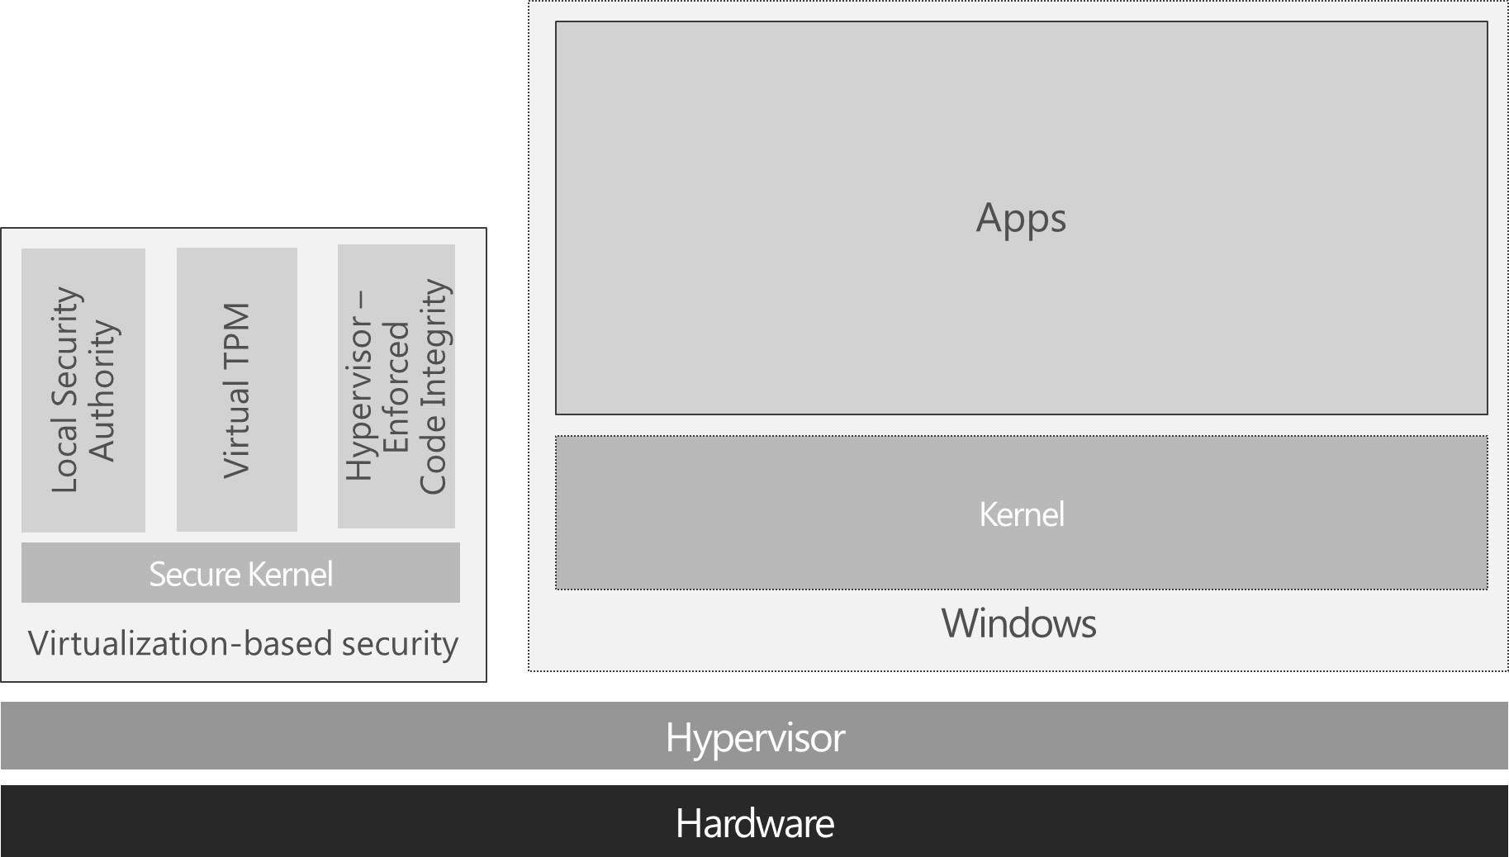
Use Windows 10 with Credential Guard
As Figure shows, Credential Guard uses VBS to isolate the LSA process and the user’s derived credentials from both user mode and kernel mode. This means that an attacker who has compromised the operating system core will still be unable to tamper with authentication or access derived credential data. Credential Guard prevents PtH and PtT attacks, which are central to the success of most major network breaches you’ve read about, making Credential Guard one of the most impactful and important features to deploy in your environment.

Slide 53
Requirements for Credential Guard
UEFI firmware version 2.3.1 or higher, with UEFI Secure Boot and Platform Secure Boot (optionally with a third-party UEFI CA removed from the UEFI database)
Virtualization support enabled by default in the system firmware (BIOS): virtualization extensions (for example., Intel VT‑x, AMD RVI), second-level address translation (for example, Intel EPT, AMD RVI), and input/output memory management unit (for example., Intel VT‑d, AMD Vi)
UEFI BIOS configured to prevent an unauthorized user from disabling Device Guard–dependent hardware security features (for example, Secure Boot)
Kernel mode drivers signed and compatible with hypervisor-enforced code integrity
Windows 10 Enterprise (x64)
Windows 10 Hyper‑V and Isolated User Mode features enabled

Slide 54
Restrict and protect local accounts with administrative privileges
Attackers can use accounts that offer administrative access on a computer to take full control of that computer. With the computer compromised, the attacker can use the accounts to access other credentials stored on the computer.
Many organizations have deployment and operational processes that store the same local administrator account and password on many computers. Identical passwords make it significantly easier for attackers to compromise all computers that use them and obtain all credentials stored on these computers.

Slide 55
Restrict and protect local accounts with administrative privileges
1
Use the Local Administrator Password Solution (LAPS) to manage local account passwords of domain-joined computers.
2
Enforce the restrictions available in Windows that prevent use of local accounts for remote administration.
3
Explicitly deny network and Remote Desktop logon rights for all local administrative accounts.
Create unique passwords for accounts that have local administrative privileges.
4

Slide 56
Restrict inbound network traffic
For an attacker attempting to carry out lateral movement or privilege escalation, he or she must be able to contact other computers on the network.
Use Windows Firewall on local workstations to restrict inbound traffic to specific services, servers, and trusted workstations you use for desktop management. To do so, deny all inbound access unless explicitly specified in a rule.
Using Windows Firewall to restrict inbound traffic is a simple and robust mitigation that can help prevent attackers from using captured hashes for lateral movement or privilege escalation. This mitigation significantly reduces the attack surface of your organization’s network resources to a PtH attack and other credential theft attacks because it disables an attacker’s ability to authenticate from any given host on a network.

Slide 57
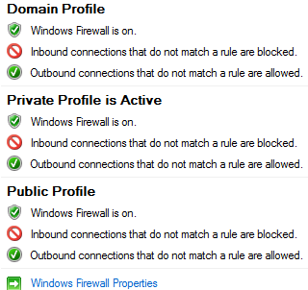
Restrict inbound network traffic
Block all inbound traffic, and then use rules to allow inbound traffic only by exception. In Windows Firewall, you can use the Block (Default) setting to configure all profiles that appear in the snap‑in, as shown in Figure.
Enable inbound exceptions for authorized hosts that your organization uses to manage workstations. To enable authorized inbound rules, you must provide IP addresses or subnets on the expected ports and protocols.

Slide 58
Additional technical countermeasures for credential theft
Do not allow Internet browsing from highly privileged accounts
Remove standard users from the local Administrators group
Use remote management tools that don’t place reusable credentials on a remote computer’s memory
Update applications and operating systems
Limit the number and use of privileged domain accounts
Secure and manage domain controllers
Remove LAN Manager hashes
Disable the NTLM protocol

Slide 59
Additional technical countermeasures for credential theft
Use MFA for user accounts
Use Microsoft Passport and Windows Hello
Use jump servers to administer isolated network segments
Detect use of stolen credentials

Slide 60
Documentation

Slide 61
Sources
Mitigating Pass-the-Hash (PtH) Attacks and Other Credential Theft
Implementation of Windows 10 security features based on virtualization - (FR)
Windows 10 Credential Theft Mitigation Guide
Mimikatz creator website
Mitigating Credential Theft using the Windows 10 Isolated User Mode
Protect derived domain credentials with Credential Guard.
Windows Passwords

